Slide 1
BIEDPA Special Education Monthly TA Call
August 14, 2018

Slide 2
Welcome Back
DPA Staff updates
Theory of Action: Marketing the Value of Education—Importance of students staying in school
SY 2017-18 Parent Surveys due date extended to September 15, 2018 for 40 schools
Program/Fiscal Onsite Monitoring Visits for SY 2018-19
15 onsite monitoring visits
20 school IEP file reviews in NASIS (sample)
2 CAU onsite reviews

Slide 3
2017 Amended Special Education Determinations —waiting for approval of letter
2018 Special Education Determinations– September 2018
Need school contact information (ph & email):
Superintendent, principal, special education coordinator, business manager, secondary transition specialists
Email to: Annette Miller: annette.miller@bie.edu

Slide 4
SY 2018-19 Special Education Calendar of due dates—posted on BIE website
SY 2018-19 Monthly TA Call & Webinars—posted on BIE website
SY 2018-19 Personnel & Related Services—schools will be contacted this fall.
Post School Outcomes data collection this fall for SY 2016-17 leavers

Slide 5
Fund Distribution Documents (FDD) are being submitted to BIE Director’s office for disbursement of funds for SY 2018-19

Slide 6
Guidance for SY 2018-19
Special education teachers should be available to provide special education services on the first day of school
Related service providers should be available on the first day of school
All students with disabilities have active/current IEPs
Services are provided and documented through:
Attendance rosters
Service logs
Delivery of missed services are documented and missed services are to be provided

Slide 7
IDEA Part B Unmet Needs Application SY 2018-19
All Schools are eligible to apply.
Unmet Needs Application posted on BIE website- Native Star; window will open September 4, 2018
Unmet Needs application webinar on August 23, 2018, 1pm -2pm (MDT)
Complete Application due September 17, 2018
Location: Native Star/Resources/Docs & Links

Slide 8
What is Unmet Needs?
An opportunity to apply for additional Part B supplemental funds if:
Priority 1 - Increase in numbers of NEW high needs students or
Priority 2 – Substantial Increase (at least 10% ) in new special education enrollment.
*Schools can apply for only Priority 1 or 2, not both.
3. Priority 3 - Unique circumstances
*Schools are eligible to request for Unique Circumstances in addition to Priority 1 or Priority 2
Notes:
The

Slide 9
How to Prepare for Unmet Needs application for SY2018-19
Components for a complete application
Unmet Needs application
Priority 1 or
Priority 2
Priority 3 with budget and narrative
Current list of SWD utilizing NASIS Adhoc Reporting
Signed by school administrator
Scan and send via email to Fiscal.Accountability@bie.edu
Current and valid IEP of each student

Slide 10
TIMELY
INITIAL
EVALUATIONS

Slide 11
REMINDER
Desk Audit Form is due on/or before September 30, 2018
Send NOW if you have them completed.

Slide 12
WHERE TO SEND
Fax number is 615-564-6631
Attention: Narcy KaWon

Slide 13
LOCATION OF DESK AUDIT FORM
The Desk Audit Form can be downloaded from Native Star under Docs & Links

Slide 14
DESK AUDIT FORM
BIE Division of Performance and Accountability (BIE-DPA)
State Performance Plan (SPP)/Annual Performance Report
Indicator 11 - Timely Evaluation for SY 2017-18
Desk Audit form

Slide 15
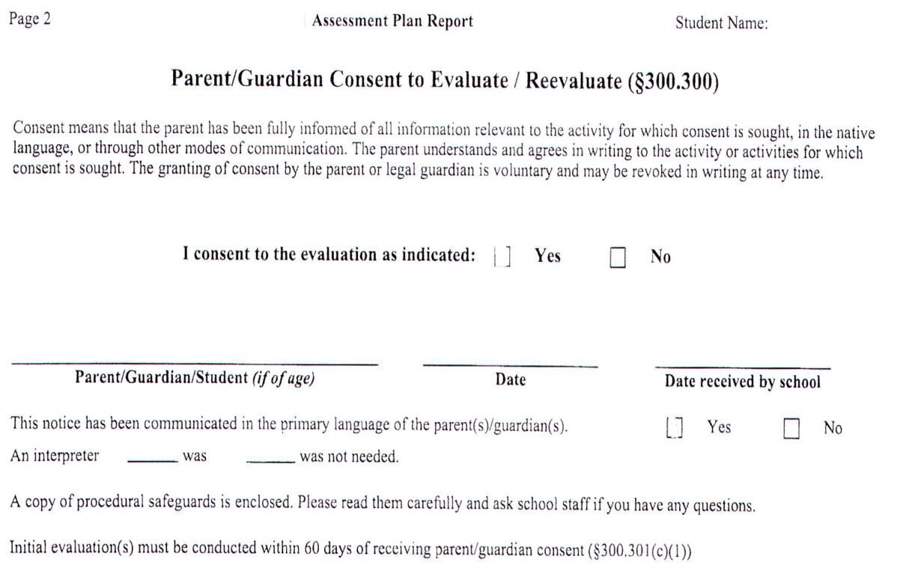
Parent Consent to Evaluate
Use the Date the document was received by the school.
This should match the date on the desk audit form.
If it does not change the date on form
Only this form is acceptable

Slide 16
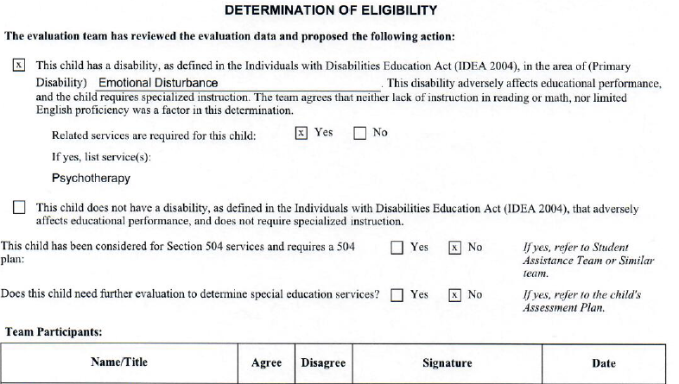
Determination of Eligibility
Located under Evaluation Summary Report
Review the form to ensure it complete & the signed dates match to the desk audit form

Slide 17
TIMELY INITIAL EVALUATION
WEBINAR
AUGUST 30, 2018

Slide 18
CONTACT INFORMATION
NARCY D. KA’WON
Phone: 615-564-6632 Fax: 615-564-6631
narcy.kawon@bie.edu
or
ZONNIE SOMBRERO
Phone: 928-283-2208
zonnie.sombrero@bie.edu

Slide 19
LSPP
Text box now open in Native Star for initial LSPP improvement activities submissions
Activities should demonstrate improvement on all BIE SPP/APR indicator targets
Timely submissions are those received by 30 September 2018
Written feedback will be provided in the order that they were submitted
A PDF copy of the LSPP guidance can be found in the school’s Native Star dashboard under Resources under the Docs & Links tab.

Slide 20
BIEDPA Special Education Announcements
August 31, 2018—correction of noncompliance due for SY 2017-18 secondary transition IEP file reviews
August 30, 2018 – Webinar for Timely Initial Evaluation September 11, 2018—Next TA call
September 17, 2018—unmet needs application due
September 30, 2018—Initial LSPPs due in Native Star
September 30, 2018 - Timely Initial Evaluation Desk Audit Form due

Slide 21
BIE Division of Performance and Accountability Special Education Staff 2018-19
Staff | Location | Email | Telephone
Connie Albert Education Program Specialist | Albuquerque, NM | connie.albert@bie.edu | 505-563-5180
Jennifer Davis Education Program Specialist | Phoenix, AZ | jennifer.davis@bie.edu | 602-265-1592
Donald Griffin Supervisory Education Specialist | Washington, DC | donald.griffin@bie.edu | 202-208-0268
Narcy Ka’won Education Program Specialist | Nashville, TN | narcy.kawon@bie.edu | 615-564-6632
Deanna Klingensmith Education Program Specialist | Seattle, WA | deanna.klingensmith@bie.edu | 206-220-7979
Marcy Oliver Education Program Specialist | Albuquerque, NM | marcy.oliver@bie.edu | 505-563-5239
Delphina Shunkamolah Education Program Specialist | Shiprock, NM | delphina.shunkamolah@bie.edu | 505-368-3407
Zonnie Sombrero Education Program Specialist | Tuba City, AZ | zonnie.sombrero@bie.edu | 928-283-2218
Dr. Eugene Thompson Education Program Specialist | Albuquerque, NM | eugene.thompson@bie.edu | 505-563-5394

