Slide 1

For BIE Schools
Diane Harris, Ph.D., M.P.H., C.H.E.S.
Centers for Disease Control and Prevention
Division of Nutrition, Physical Activity and Obesity
The conclusions in this presentation are those of the author and do not necessarily represent the views of the Centers for Disease Control and Prevention.

Slide 2
Outline
Why salad bars in schools
What is Let’s Move Salad Bars to Schools?
  Tour of website
  How do I apply for a salad bar?
Other resources:
  Funding
  Operations

Slide 3


Why Salad Bars?
Provides a variety of appealing F&V choices
Easiest way to meet new school meal standards
Facilitates meeting HUSSC guidelines
Compatible with “Half a Plate F&V” message

Slide 4
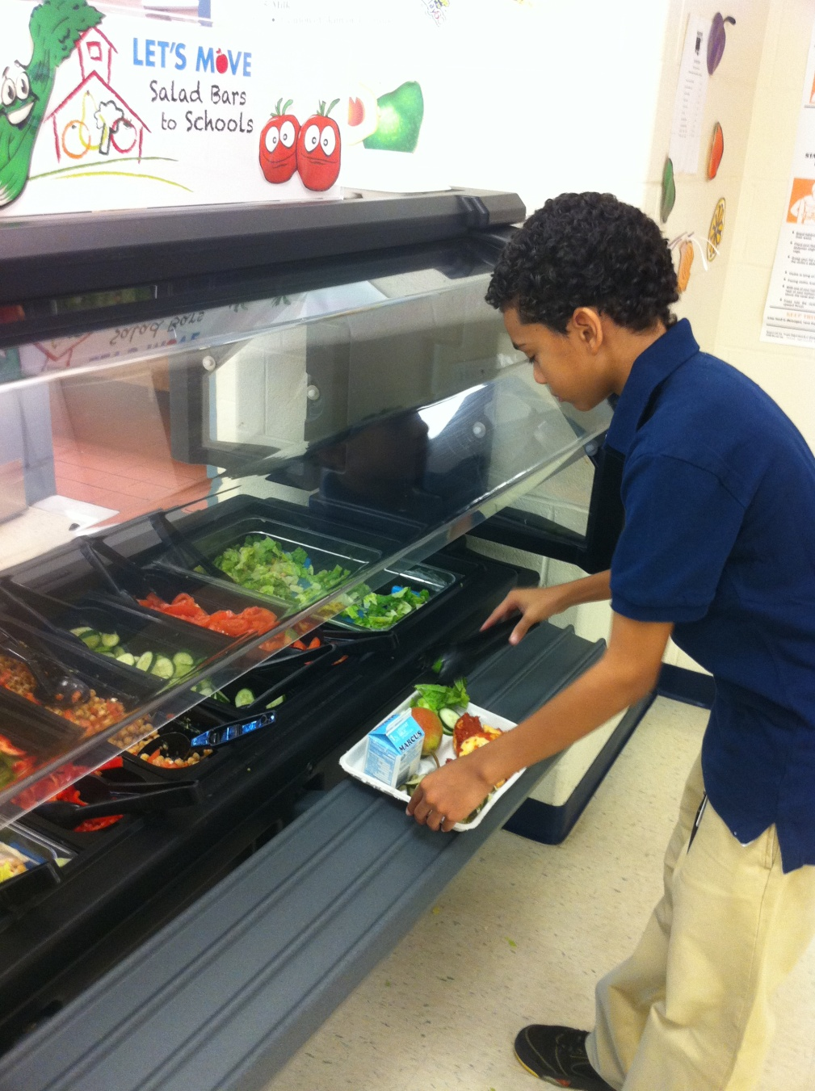
Choice Matters!

Slide 5
Salad Bar Evaluation Data
Daily frequency of F&V consumption increased in students after introduction of salad bar
  Los Angeles Unified SD [Slusser et al, 2007 Pub. Health. Nut. 10(12):1490]
Students who chose the salad bar ate more servings of F&V than students who chose the hot entrée
  Riverside Unified SD [Center TRT http://www.center-trt.org ]

Slide 6
Other Benefits of Salad Bars
Enhance revenue for school meal programs
Increase school meal participation
Improve how the public views the school meal programs

Slide 7
MANY SCHOOLS IN THE U.S. ALREADY HAVE SALAD BARS…
MANY OTHER SCHOOLS WANT SALAD BARS BUT CAN’T AFFORD TO PURCHASE THEM

Slide 8
Let’s Move Salad Bars to School
A comprehensive public health effort to mobilize and engage stakeholders at the local, state and national level to support salad bars in schools
Goal – donate 6,000 salad bars in 3 yrs
Progress – over 1,000 salad bars donated
Notes:
8

Slide 9




LMSB2S Founding Members

Slide 10















National Fruit & Vegetable Alliance

Slide 11
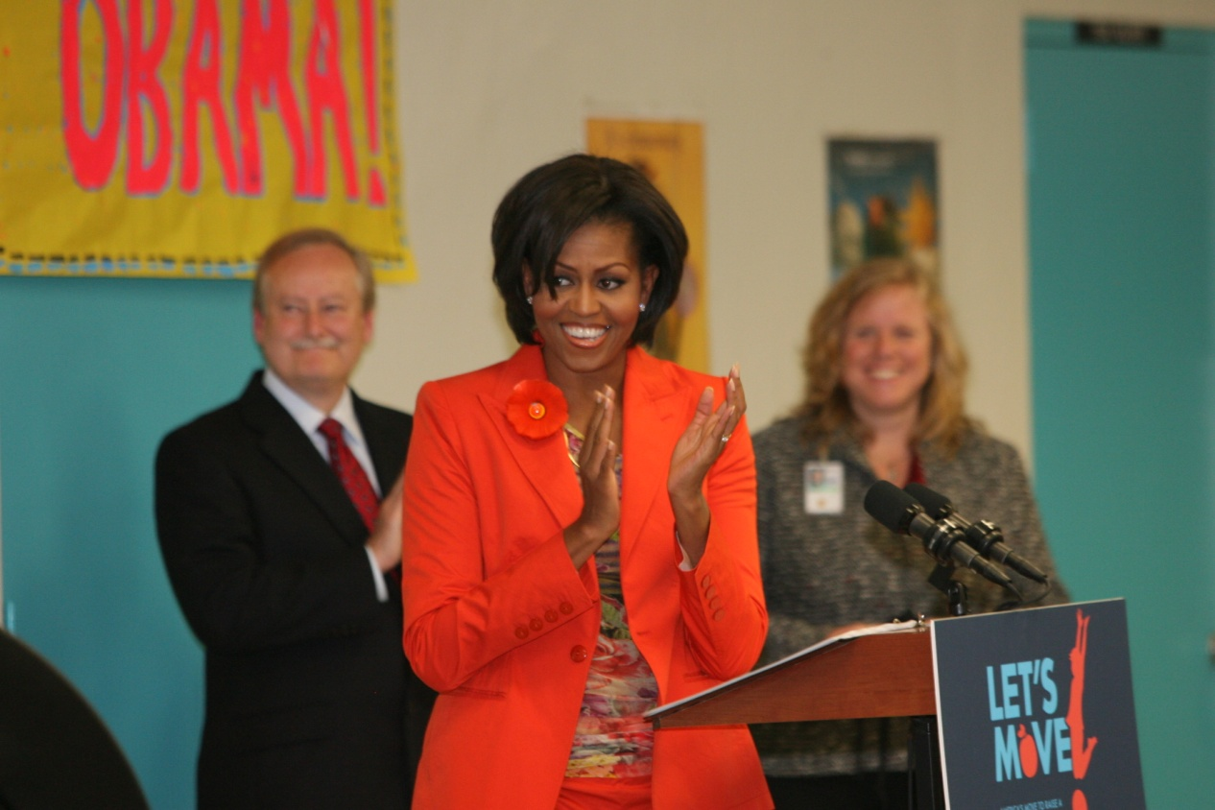
Let’s Move Salad Bars to Schools Launch
November 22, 2010
Riverside Elementary School, Miami

Slide 12
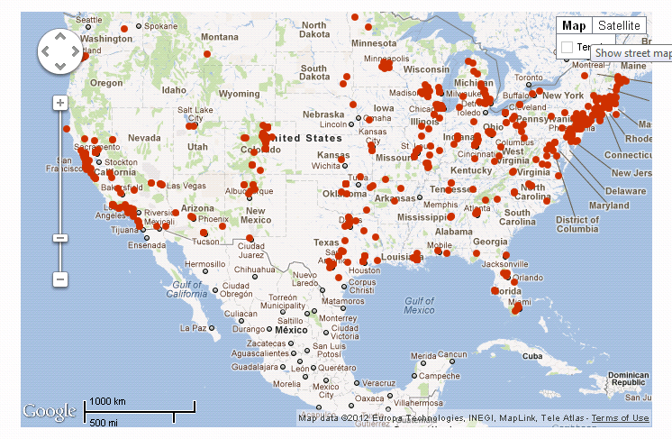

Slide 13
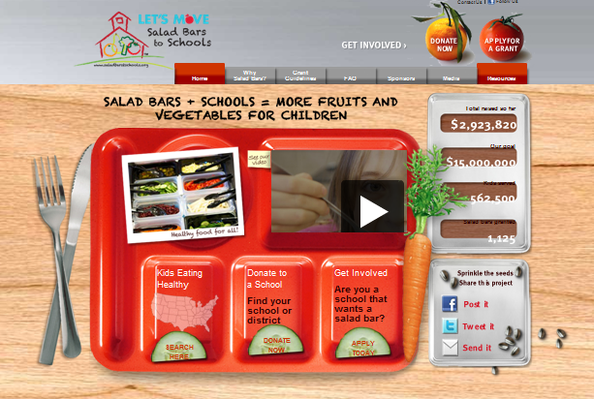
www.saladbars2schools.org
Notes:
13

Slide 14
Schools/Districts Must Apply Online
Online district application
  Allows for 1 application for multiple schools
Approval required from Nutrition Services Director and Superintendent
Priority
  HUSSC Awardees
  All schools in NSLP – prioritized based on % free/reduced & commitment to salad bars
Notes:
14

Slide 15
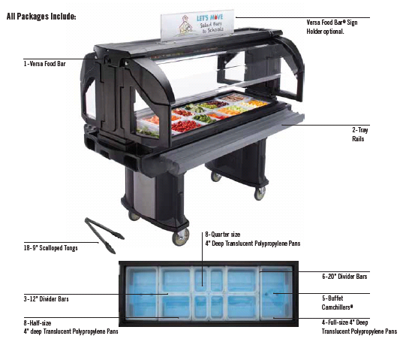
LMSB2S Salad Bar Package
Cambro portable 72” 5-well insulated salad bar with two tray rails (regular or low height)*
  Buffet Camchillers®
  Translucent polypropylene food pans
9” Scalloped serving tongs
* Vollrath electric (mechanically cooled) salad bar also available by special request

Slide 16
Application Questions?
p. 24
info@saladbars2schools.org

Slide 17
Two Ways to Raise Funds
Local fundraising
  Social media
  Local donors
Grant award
  HUSSC Schools
  High F/R

Slide 18
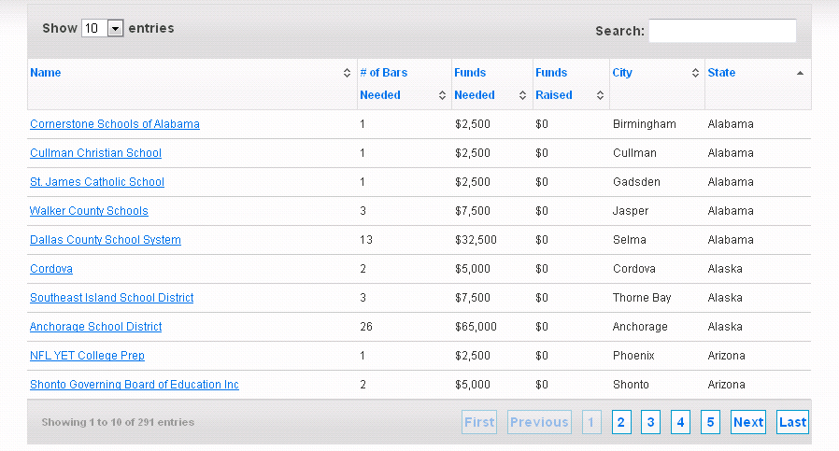
Every District is Listed

Slide 19

Local Funding Opportunities
Fuel Up to Play 60
  Dual-use as breakfast kiosks
Local Foundations, Civic Groups, Businesses
Health Care Organizations

Slide 20
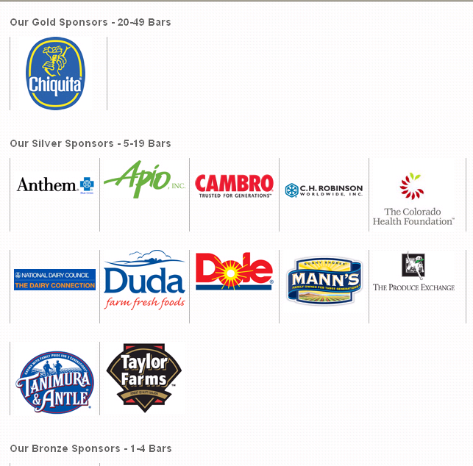
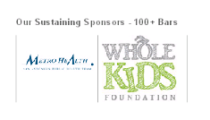
LMSB2S Partners and Sponsors

Slide 21
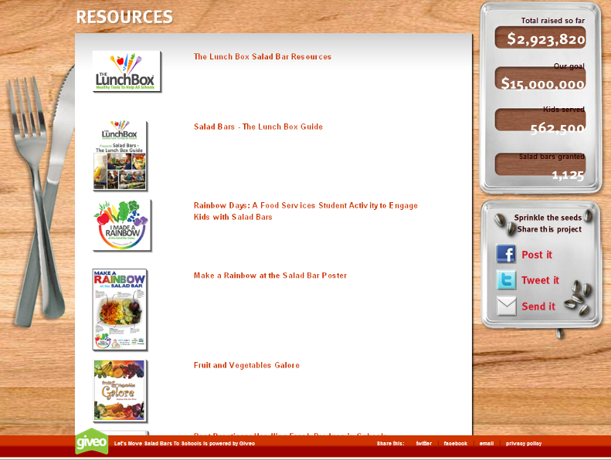
Salad Bar Resources

Slide 22

USDA Salad Bar Guidance
Fruit and Vegetables Galore
  http://www.fns.usda.gov/tn/resources/fv_galore.html
Best Practices: Handling Fresh Produce in Schools
  http://www.fns.usda.gov/fns/safety/pdf/best_practices.pdf
USDA Memo SP 02-2010 – Revised
  http://www.fns.usda.gov/cnd/governance/Policy-Memos/2011/SP02-2011revised_os.pdf

Slide 23
NFSMI Guidance
Webinar “Salad Bars in School Nutrition Programs” (12/8/11)
  http://www.nfsmi.org/ResourceOverview.aspx?ID=407
Handling Fresh Produce on Salad Bars
  http://nfsmi.org/documentlibraryfiles/PDF/20110822025744.pdf
HACCP Based SOPs - Preventing Contamination at Food Bars
  http://sop.nfsmi.org/HACCPBasedSOPs/PreventingContaminationatFoodBars.pdf

Slide 24


Resources from Other Partners
The Lunchbox
  http://www.thelunchbox.org/resources
  Information on operating salad bars
National Fruit and Vegetable Alliance
  http://www.nfva.org/alliance_collaborations.html
  Fundraising toolkit
Produce for Better Health Foundation
  http://www.pbhcatalog.com/
  Posters and other promotional materials for lunchrooms

Slide 25

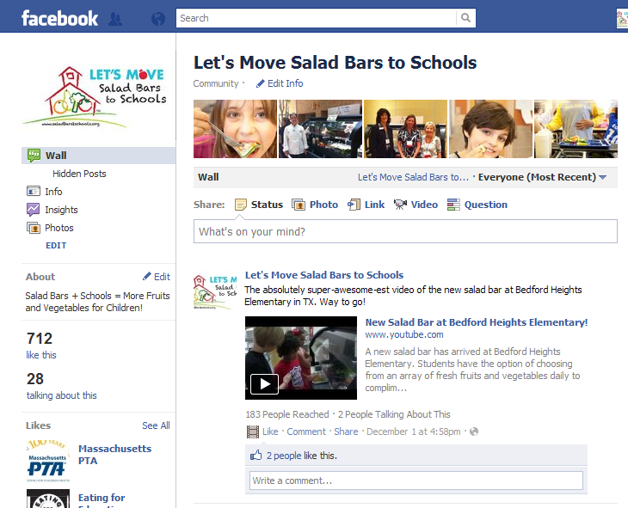

Social Media for LMSB2S
Badge
Facebook
Ecard
http://www.cdc.gov/SocialMedia/Tools/ButtonsBadges.html
http://www2c.cdc.gov/ecards/

Slide 26
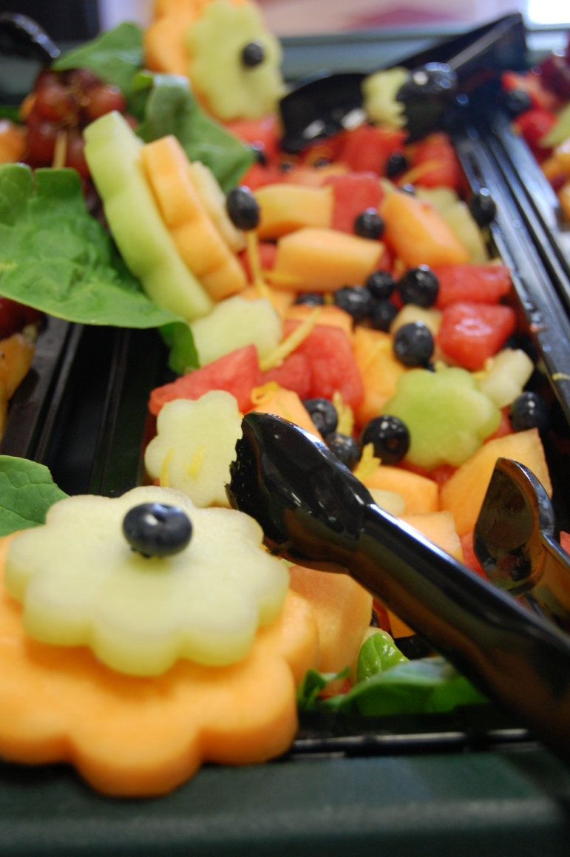
Questions -- dmharris@cdc.gov
“When food is fresh and user-friendly, when the salad bar smiles with colors and varieties, kids don’t have to be coerced into eating”
Rodney Taylor
Riverside Unified School District
Notes:
26

Slide 27

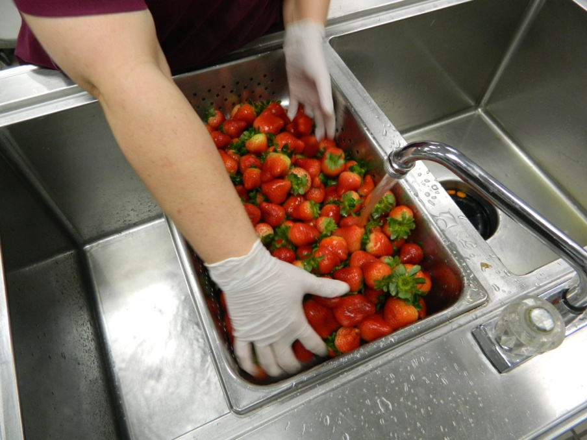
Angelia Dowty
Food Service Director
Sequoyah Schools, Tahlequah, OK

