Slide 2
SESSION 15
Budget and Finance

Slide 3
June 7-9: Angela Salazar, BIE Supervisory Financial Specialist
June 14-16: Jake Coury, Senior Program Analyst, BIE Budget Administration
June 28-30: Douglas Ward, Supervisory Budget Analyst, Budget Formulation and Execution Branch
July 6-8: Larry Palmer, BIE Supervisory Budget Officer
July 12-14: Larry Palmer/Douglas Ward, Supervisory Budget Officer and Supervisory Budget Analyst

Slide 4

Agenda
Budget and Finance Organization
BIE Budget Overview
School Allocations
Teacher Pay Parity
Annual School Spending Goals
Tribal Grant Support Costs
School Approval and Certification of Funds
Tribal Grant Support Costs
Financial Assistance and Reporting
Student Transportation
Questions

Slide 5

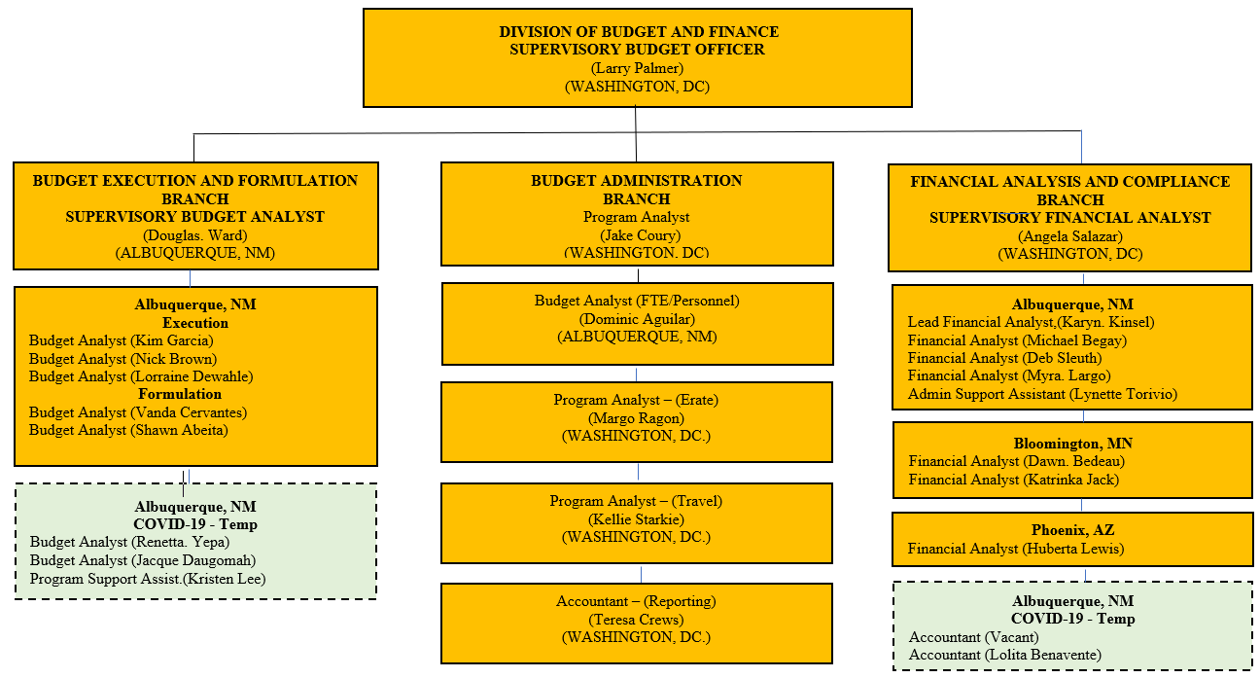
Organization

Slide 6
BIE Annual Budget Overview
Fund | 2021 Enacted | 2022 Enacted | 2023 Request | 2023 %
OIEP | 973,092 | 1,017,601 | 1,155,634 | 73%
Construction | 264,277 | 264,330 | 420,102 | 27%
Total BIE | 1,237,369 | 1,281,931 | 1,575,736 | 100%
BIE Budget Available on BIE.edu under School Operations
Education Program funding is 2 years
Both Forward Funding (SY) and Non-forward funding

Slide 7


School Budget Allocations
ISEP funding is main source of K-12 resources
Each year Congress appropriates ISEP funding which is then distributed to K-12 schools
ISEP Funding Formula
Academic (student count) funding factors by grade level drives most funding
Gifted & Talented & Language Development weights add additional funding as well as small school adjustments and residential counts

Slide 8
Key Allocation Funding Drivers
Student attendance
Weighted program participation
  CFR 25 39.102 What is academic base funding?
    ADM times Weighted Student Unit (WSU).
    Average Daily Membership (ADM) is ISEP-eligible membership of a school for a SY, divided by number of school days in school calendar
Grade Level | Base Academic Funding Factor | Base Residential Funding Factor
Kindergarten | 1.15 | NA
Grades 4-6 | 1.15 | 1.60
Grades 1-3 | 1.38 | 1.75
Grades 7-8 | 1.38 | 1.60
Grades 9-12 | 1.50 | 1.60

Slide 9
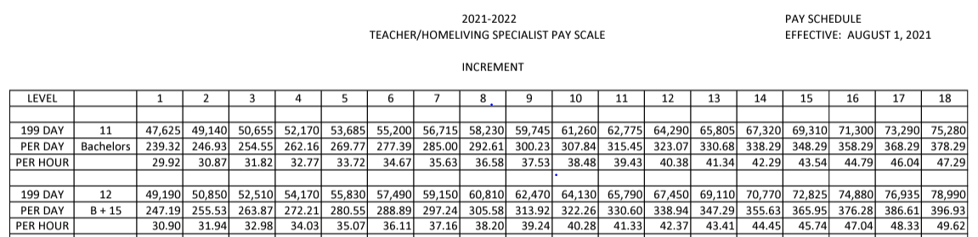
BIE Teacher Pay Parity
BIE annual budget requests include fixed costs for teacher pay
raises - total BIE fixed costs in the 2023 Request exceed $18m
Pay raise requests are funded via fixed costs and based on DoDEA
(Department of Defense Education Activity) benchmark pay scales
Pay raise fixed costs are distributed to the ISEP budget line
Congress supports grant schools setting pay at DoDEA benchmarks

Slide 10
BIE Funding Per Student - 2023
The proposed level of funding for SY 2023-2024 is projected to provide an estimated $6,910.18 per WSU.
K-12 student transportation and O&M funding allocations to all schools is over $200 million (see below) these are the remaining (Non-ISEP) material funding accounts. Divided by ADM ($207,439,000/40,624) student transportation and O&M funding is prorated at approximately $5,000 per student
Elementary and Secondary Programs - 2023
Student Transportation | $ 61,007,000
Facilities Operations | $ 76,888,000
Facilities Maintenance | $ 69,544,000
Total | $ 207,439,000
ADM @ BIE.edu | 40,624
ADM Prorated Student Transportation & O&M | $ 5,106

Slide 11
Tribal Grant Support Costs (TGSC)
The proposed level of funding for SY 2023-2024 is $97M
A major goal of BIE is to facilitate Tribal sovereignty over education by assisting Tribes in assuming the operation and management of BIE schools.
BIE provides administrative cost grants (subject to availability of funds) to Tribes which have assumed operation and management of a BIE-funded school.
TGSC is a factor of funds managed through the SY by Tribal Schools
Includes both appropriated & Department of Education funds
80% of calculated TGSC is distributed July 1st
20% of funds available SY funds are fully allocated
Timing of 2nd payment (20%) subject to Congressional
action

Slide 12
Department of Education (DOE) Allocations
Annually schools receive budget allocations over $227m
Budget funding dependent upon application requirements

Slide 13
One-Time School Funding Resources
COVID-19
ESF-II Funds (BOS) expire on 9/30/22
ARP funds are available until expended

Slide 14
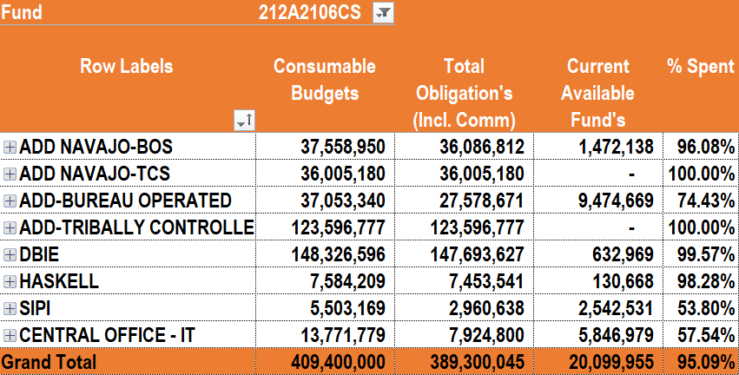
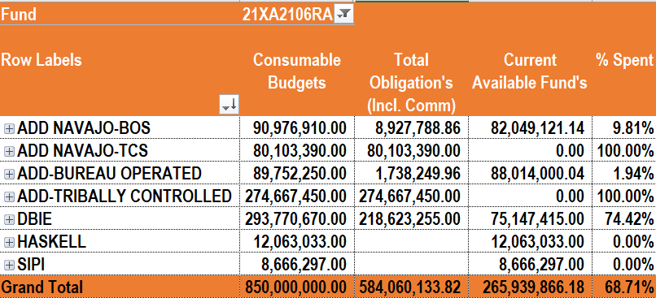
Remaining COVID-19 Funding Resources
ESF-II 95% Obligated
ARP – 69% Obligated
Target goal is 100% ESF-II spending
ARP funds are available for long term planning

Slide 15

School Facilities Operations & Maintenance
Allocation Procedures
O&M allocations determined by BIA Division of Facilities Management and Construction (DFMC)
Allocation levels based on actual facilities and conditions and address regional costs, utilities, custodial services, preventive maintenance, unscheduled maintenance, efficient use of classrooms, and program administration and support.
O&M allocations received from BIA are distributed within 3 days
O&M is not forward funded - subject to Continuing Resolutions

Slide 16

Student Transportation Allocations
COVID-19 blanket waivers for student and commercial transportation have protected funding at SY 19-20 levels
WebET 2.0 (BIE Education Transportation Reporting System) is being updated to provided improved school reporting of mileage and commercial transportation expenses
Mileage counts and commercial transportation are key cost driver for allocations
Total mileage divided by annual appropriations determine the per mile funding available
1.2 multiplier added for unimproved miles

Slide 17

Student Transportation Reporting
Day Student Mileage Count:
Student mileage count week is last full week of September
  School must report mileage for T, W, TH, for each bus
  School mileage must be certified at the school level, EPA level, and certifying official
  The average of these 3 days will be taken and multiplied by 180 to calculate the total mileage

Slide 18
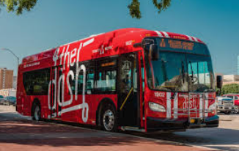
Residential Transportation Reimbursement
Residential School Mileage/Expense Count:
Schools must report cost of commercial expense to get students from home to school in fall
Schools must also report mileage associated with getting students from home to school in fall
These expenses and counts will be multiplied by four to calculate funding distributions
Timely submission ensures reimbursements

Slide 19

Student Transportation Safety
Student Transportation Safety Standards:
All vehicles used by schools must meet or exceed Federal Motor Vehicle Safety Standards (FMVSS) and State or Tribal standards
Vehicles with a rated seating capacity of 10 must meet FMVSS for school buses
All bus drivers must have a Commercial Driver's License (CDL)
Improving driver pay, retention, and recruitment
is key goal of budget planning efforts

Slide 20

Specific Program Allocations
Budget distributes the following allocations:
  Family and Child Education (FACE)
  Native Language Immersion program funding
  School Improvement Specialist
  National Teacher Certification funding
  Safe and Secure program funding
School-Level Resources Available
Schools can receive additional resources through:
  Adding FACE programs
  Developing Native Language Immersion programs
  Supporting teacher certification professional development

Slide 21

School Financial Reporting
Bureau reporting requirements includes the following:
  Monthly obligation tracking (spending)
  Quarterly undelivered orders status (UDOs)
  Quarterly Financial Reviews
  Internal Control Reporting (Assessable Units)
School-Level Funds Management
Best practices school management of funds include the following:
  Approving and certifying school funding
  Monitoring school spend plans during the SY period
  Recruiting and retaining staff to meet personnel planning goals

Slide 22

School Close-out Procedures
SEPTEMBER 30 CLOSEOUT – ALL FUNDS SHOULD BE SPENT
JULY 1 BALANCES (2-year Funds)
    Ensuring contracts are paid out and fully expended
    Reviewing expenditures for appropriate accounting codes
    Available Balances indicate the carryover amounts
OCTOBER 1 BALANCES (Facilities O&M)
SPEND CARRYOVER BALANCES BEFORE NEW FUNDS ARE USED
LIMITATIONS
  TITLE 1 15% - What’s the plan to fully expend these funds?
  *STRIVING FOR NO CARRYOVER*

Slide 23

Finance Technical Assistance
Technical Assistance
Fiscal team members provide technical assistance during review visits and on an ongoing basis. This assistance includes answering questions, facilitating dialogue, and exchanging ideas and information for program support and improvement.
Putting Funds to Good Use
Monitoring federal taxpayer resources supports our high-quality education services. It is a collaborative partnership between BIE support staff, BIE-funded schools, and the U.S. Department of Education.

Slide 24

Ongoing Budget Projects/Activities
Improving the financial monitoring of BIE-funded schools
Funding eLMS (Education Learning Management System)
Monitoring Full-Time Equivalent (FTE) staffing levels
Supporting Transportation Fleet Management Planning
Enabling continued BIE capacity-building
Efficiently spending ARP funding
Establishing new BIE accounting structures
Effectively justifying BIE resource requirements

Slide 25
QUESTIONS?

Slide 27

End of Day Survey

